Slide 1
Authentication Using Tokens for AngularJS, OWIN, ASP.NET Web API & Identity
1:15 PM / Ballroom C

Slide 2

Mark A. Wilson
www.developerinfra.com
@DeveloperInfra
Notes:
17 notable references in Wikipedia.

Slide 3


Logical Advantage
www.logicaladvantage.com
markw@
Notes:
Business cards up front.

Slide 4



Charlotte, NC
Enterprise Developers Guild www.developersguild.org
Spark Conference www.sparkconf.org
Blend Conference www.blendconf.com
Notes:
17 notable references in Wikipedia.

Slide 5

Sponsors
Thank You!

Slide 6
Authentication Using Tokens for AngularJS, OWIN, ASP.NET Web API & Identity

Slide 7
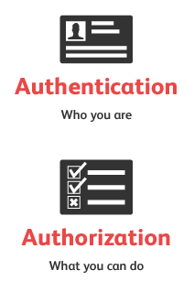
Authentication
Authorization
Who You Are
What You Can Do

Slide 8
Authentication
Cookie-Based
Token-Based
Pros
Decades-Old & Widely Used
Cons
Man-In-The-Middle (MITHM)
Cross-Site Scripting (XSS)
Cross-Site Request Forgery (CSRF)
Pros
Stateless & Scalable Servers
Mobile Friendly
Pass Authentication To Other Applications
Extra Security
Cons
Cross-Site Scripting (XSS)
https://scotch.io/tutorials/the-ins-and-outs-of-token-based-authentication
http://sitr.us/2011/08/26/cookies-are-bad-for-you.html
Notes:
Two common approaches.
You can guard against MITM attacks and against some XSS attacks by combining the “secure” and “httpOnly” flags on cookies and by using HTTPS. But there is nothing that will make cookie authentication resistant to CSRF attacks.

Slide 9
Authentication
Cookie-Based
Token-Based
Pros
Decades-Old & Widely Used
Existing Server App Support
Cons
Man-In-The-Middle (MITHM)
Cross-Site Scripting (XSS)
Cross-Site Request Forgery (CSRF)
Pros
Stateless & Scalable Servers
Mobile Friendly
Cross-Domain / Cross-Origin Resource Sharing (CORS) AJAX
Decoupled Token Generation
CSRF Protected
CDN Asset Hosting
Improved Performance
Standard-based JWT
https://auth0.com/blog/2014/01/07/angularjs-authentication-with-cookies-vs-token/
Notes:
Many reasons why a token-based approach is preferred.
* Pass Authentication To Other Applications
* Extra Security

Slide 10


Token-Based Authentication
DEMO

Slide 11
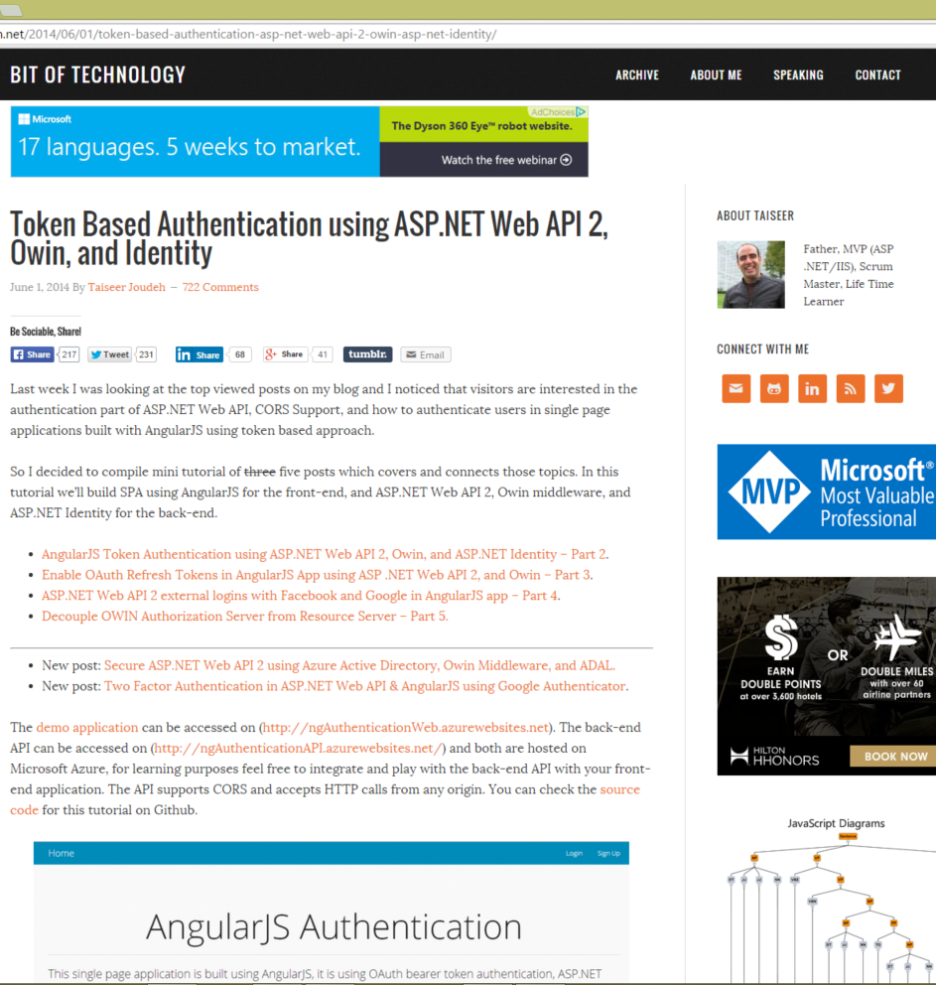
Demo
Code based on the online tutorial, "Token Based Authentication using ASP.NET Web API 2, Owin, and Identity" by Taiseer Joudeh, MVP.
http://bitoftech.net/2014/06/01/token-based-authentication-asp-net-web-api-2-owin-asp-net-identity/

Slide 12
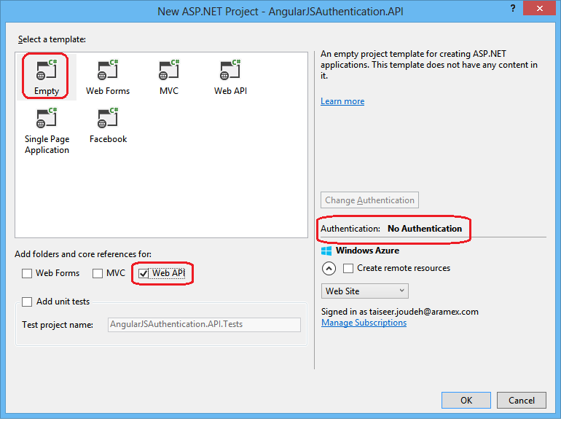
Lightweight Solutions & Projects
Less is more.

Slide 13
NuGet Packages
Microsoft.AspNet.WebApi
Microsoft.AspNet.WebApi.Owin
Microsoft.Owin.Host.SystemWeb
Microsoft.Owin.Security.OAuth
Microsoft.Owin.Cors
*Microsoft.AspNet.Identity.Owin
*Microsoft.AspNet.Identity.EntityFramework
*Authentication API Project Only
The magical number 7.

Slide 14
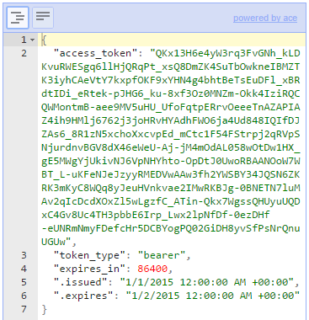
Example Token
It is JSON.

Slide 15
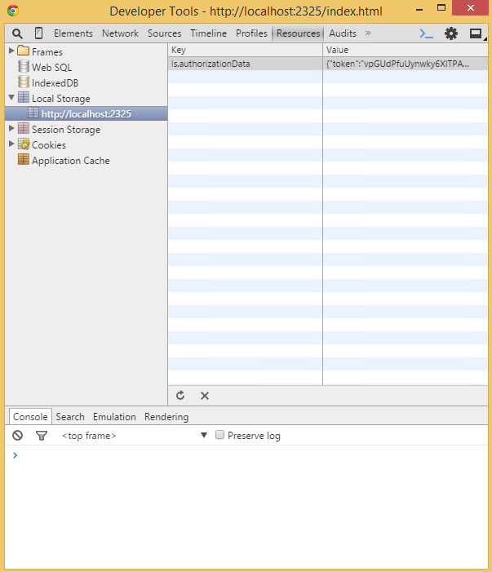
Local Storage
Other options include JavaScript or a Cookie.

Slide 16
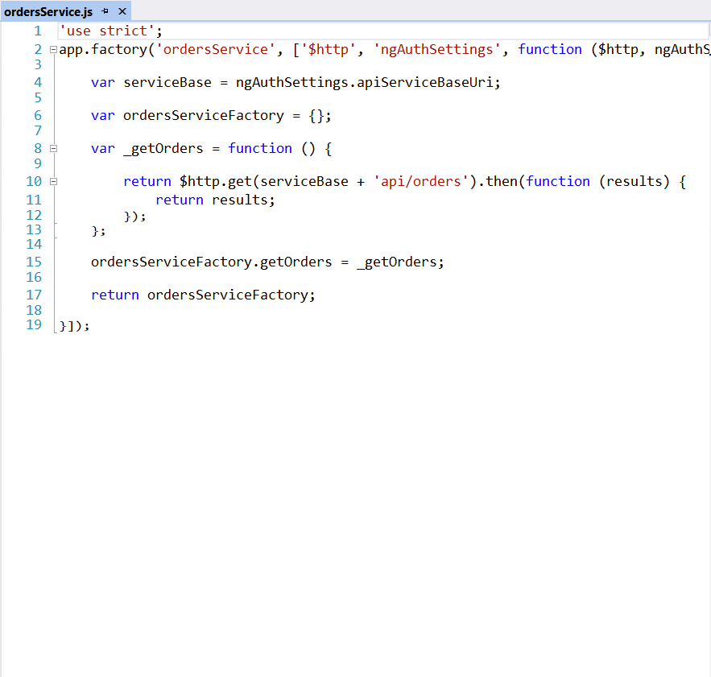
AngularJS Service
Move along, nothing to see here.

Slide 17
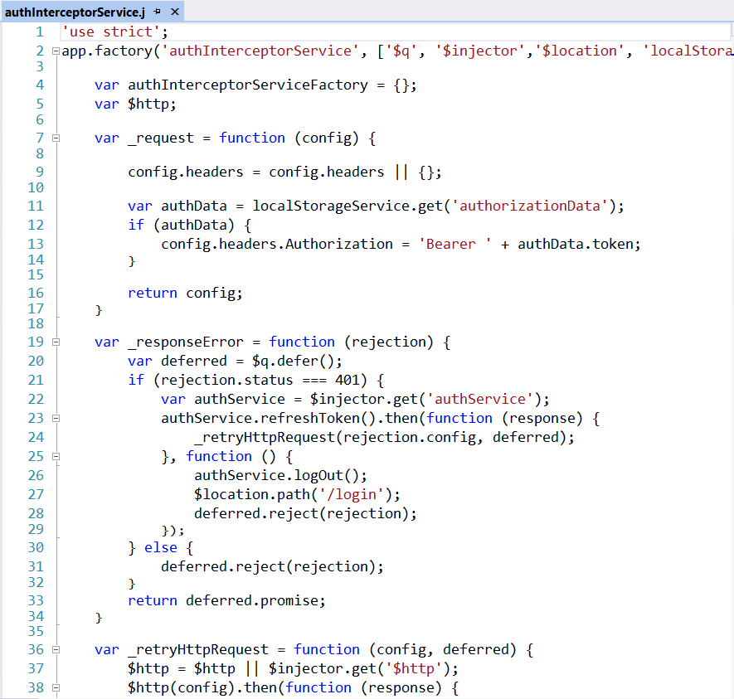
AngularJS Interceptor
Pre- and post-processing.

Slide 18
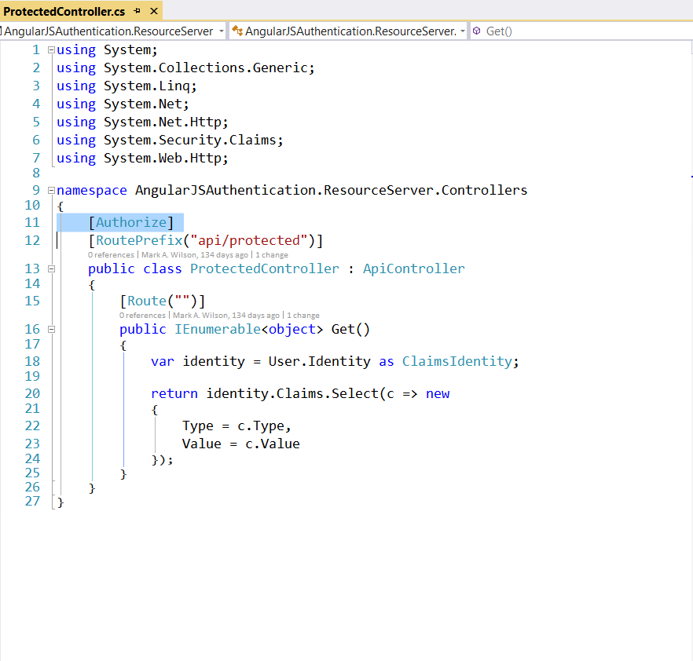
ASP.NET Web API Controller
You shall not pass!

Slide 19
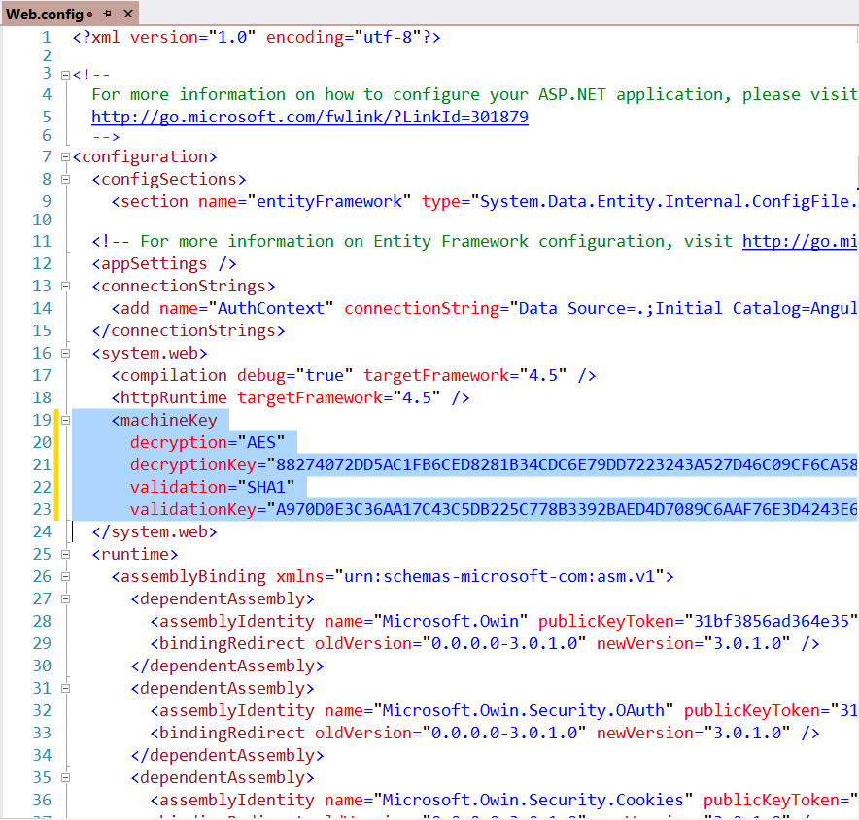
Shared MachineKey
Do not use the same keys for dev & prod.

Slide 20
Demo
Code based on the online tutorial, "Token Based Authentication using ASP.NET Web API 2, Owin, and Identity" by Taiseer Joudeh, MVP.
http://bitoftech.net/2014/06/01/token-based-authentication-asp-net-web-api-2-owin-asp-net-identity/

Slide 21
Lessons Learned
Use HTTPS over TLS/SSL!
Forms Authentication
Third-Party Logins (Facebook, Twitter, etc.)
Custom Grant Type
Entity Framework
[Public-facing] Production Ready?
Auth0.com
OAuth.io
Thinktecture IdentityServer
DotNetOpenAuth
Spring Social for .NET
etc.
Notes:
HTTPS: Use it!
Forms Auth: Happy path, easiest to setup. Transmits in clear text.
3rd-Party Logins: All implemented differently. Takes time.
Custom Grant Type: Forms vs. 3rd-Party take separate paths.
Entity Framework: Everything uses it by default.
Production Ready: Maybe not public-facing. Very little validation/checking.

Slide 22
OAuth Refresh Tokens

Slide 23
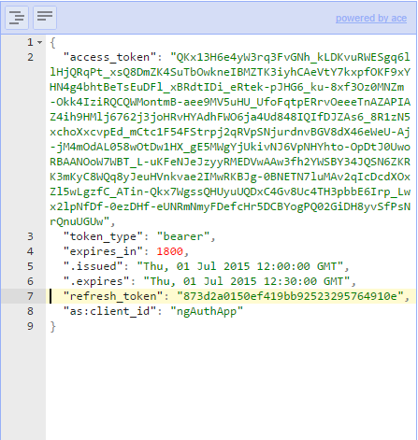
Example Token
It is a GUID.

Slide 24
Lessons Learned
Pros
Updating access token content.
Maintaining authenticated users list.
Revoking access from authenticated users.
Prompting to login multiple times not necessary.
Cons
Adding a lot of complexity.
Using third-party logins?

Slide 25
Custom ASP.NET Identity Provider
Notes:
Dapper.NET

Slide 26
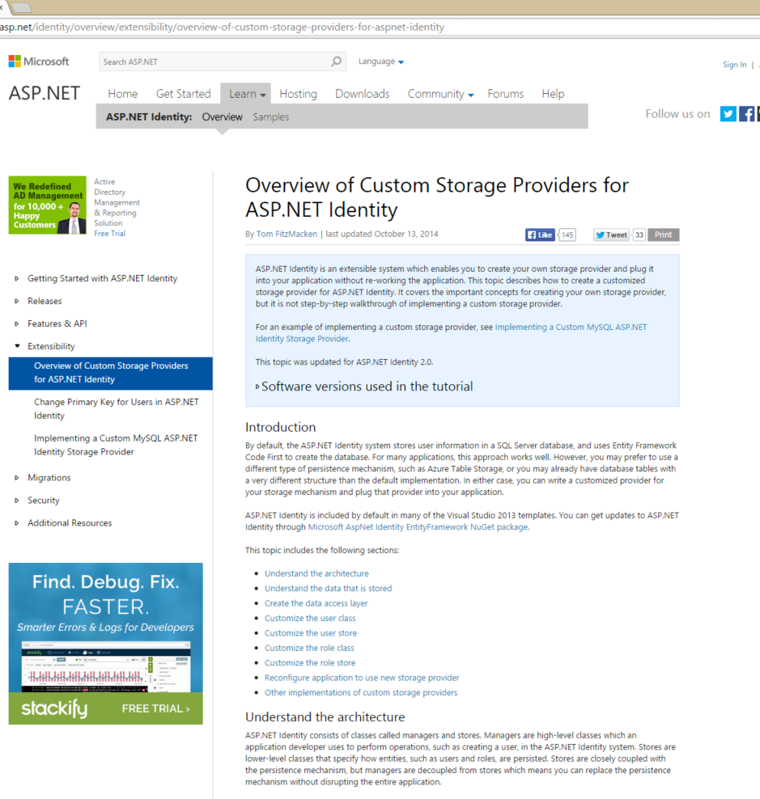
Custom Provider
For when you want something other than Entity Framework or a GUID primary key.
http://www.asp.net/identity/overview/extensibility/overview-of-custom-storage-providers-for-aspnet-identity

Slide 27
Architecture
ASP.NET Application
Managers (UserManager, RoleManager)
Stores (UserStore, RoleStore)
Data Access Layer (Dapper.NET)
Data Source (SQL Server, MongoDB, MySQL, etc.)
Your application interacts with the managers, and stores interact with the data access layer.
http://www.asp.net/identity/overview/extensibility/overview-of-custom-storage-providers-for-aspnet-identity
Notes:
Handful of OSS projects did this wrong!

Slide 28
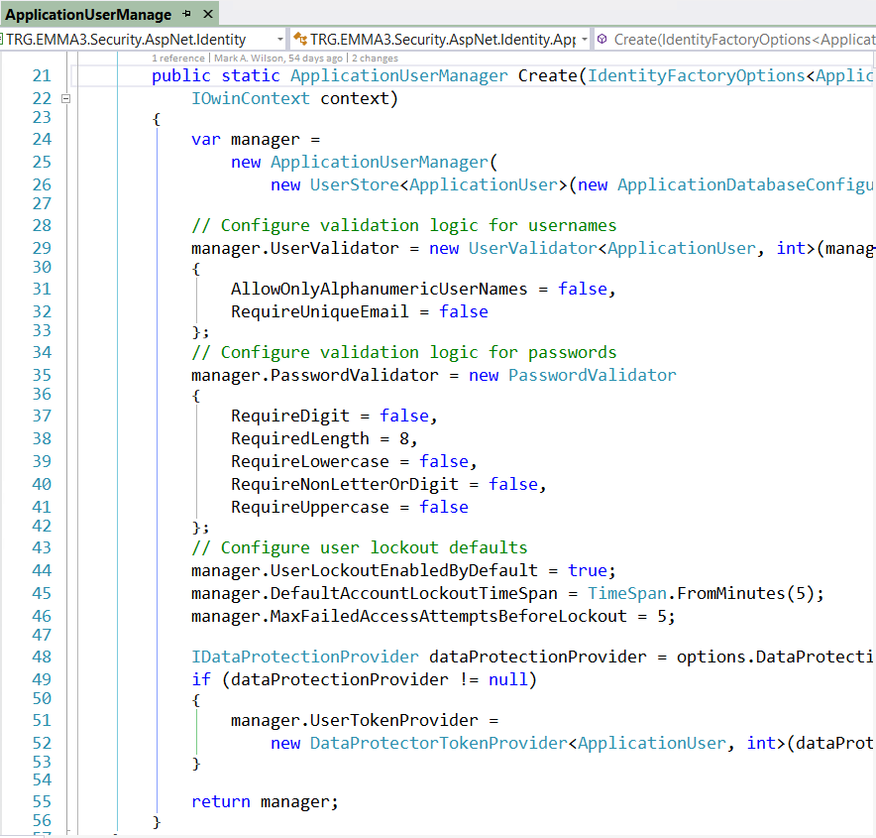
UserManager
All configuration.

Slide 29
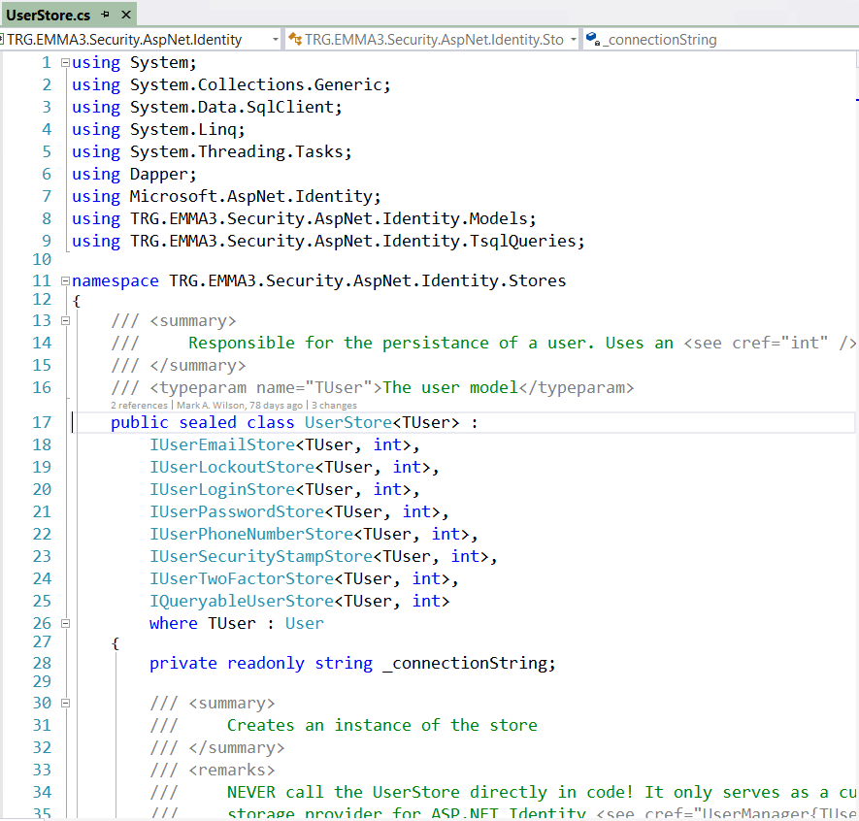
UserStore
Gets/Sets don’t alter data in the Data Source (DB).

Slide 30
Lessons Learned
Pretty easy to create.
Permits integer primary key.
Interact with managers, not stores.
Gets/Sets don’t alter data in the Data Source (DB).
In OAuthConfig, configure the database context, user manager, and role manager to use a single instance per request.
Notes:
HTTPS: Use it!
Forms Auth: Happy path, easiest to setup. Transmits in clear text.
3rd-Party Logins: All implemented differently. Takes time.
Custom Grant Type: Forms vs. 3rd-Party take separate paths.
Entity Framework: Everything uses it by default.
Production Ready: Maybe not public-facing. Very little validation/checking.

Slide 31
Mixed Authentication

Slide 32
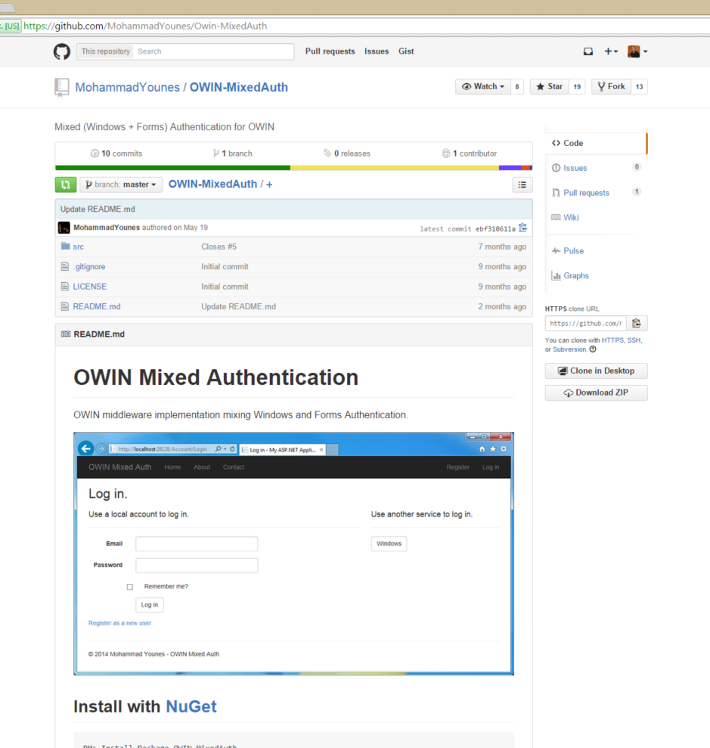
OWIN MixedAuth
Third-party Windows login provider.
https://github.com/MohammadYounes/Owin-MixedAuth

Slide 33
Lessons Learned
Proof of concept?
Enable Windows Authentication.
Required small code changes.
Uses a pop-up window.
Uses a cookie.
Notes:
HTTPS: Use it!
Forms Auth: Happy path, easiest to setup. Transmits in clear text.
3rd-Party Logins: All implemented differently. Takes time.
Custom Grant Type: Forms vs. 3rd-Party take separate paths.
Entity Framework: Everything uses it by default.
Production Ready: Maybe not public-facing. Very little validation/checking.

Slide 34
Resources
Fiddler (http://www.telerik.com/fiddler)
Token Based Authentication using ASP.NET Web API 2, Owin, and Identity (http://bitoftech.net/2014/06/01/token-based-authentication-asp-net-web-api-2-owin-asp-net-identity/)
Overview of Custom Storage Providers for ASP.NET Identity (http://www.asp.net/identity/overview/extensibility/overview-of-custom-storage-providers-for-aspnet-identity)
OWIN Mixed Authentication (https://github.com/MohammadYounes/Owin-MixedAuth)
Notes:
HTTPS: Use it!
Forms Auth: Happy path, easiest to setup. Transmits in clear text.
3rd-Party Logins: All implemented differently. Takes time.
Custom Grant Type: Forms vs. 3rd-Party take separate paths.
Entity Framework: Everything uses it by default.
Production Ready: Maybe not public-facing. Very little validation/checking.

Slide 35

Authentication Using Tokens for AngularJS, OWIN, ASP.NET Web API & Identity
Mark A. Wilson Senior Developer MarkW@LogicalAdvantage.com
www.DeveloperInfra.com @DeveloperInfra

